Slide 1
How to use this template:
There are ~50 slides in this presentation, so you likely will not use them all (some are intentionally repetitive to provide options). This is the most up-to-date MANRS messaging, graphics, notes, etc. Take what you need, leave the rest!
Cut out the slides irrelevant to your audience, and/or add new information as needed.
Please share your presentation with us. Send it to manrs@isoc.org naming it YYYYMMDD_EVENTNAME_MANRS.ppt.
If you find an error in the original slides, let the MANRS team know so they can fix it in the template for the next person. Write to us at contact@manrs.org.

Slide 2
Mutually Agreed Norms for Routing Security
NAME
EMAIL

Slide 3
Why Does Routing Security Matter?
A Routing Overview

Slide 4
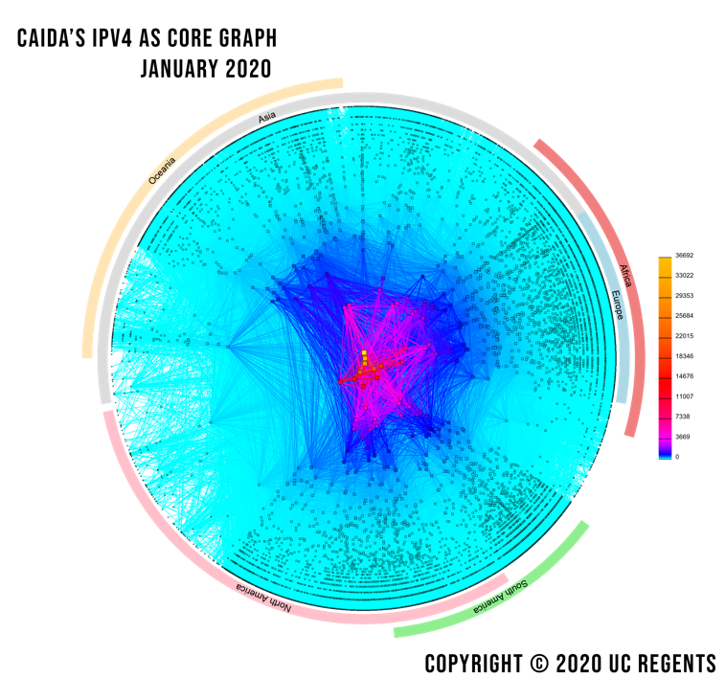
An Extremely Condensed Routing 101
There are ~74,000 independent networks that together make up the Internet.
Each network is identified by an Autonomous System Number, or ASN.
Each ASN makes its own decisions about how to move Internet traffic using a language called Border Gateway Protocol, or BGP.
BGP is a fundamental underpinning of the Internet.

Slide 5

The Problem with BGP
BGP was created in 1989, before Internet security was a concern.
BGP assumes all networks are trustworthy. Any network can announce it has a path to any other network, even if it does not.
There is no built-in security mechanism to check if traffic is legitimate or not.
On today’s Internet, this is a problem.
BGP is vulnerable to both malicious attacks and human mistakes.
Photo by charlesdeluvio on Unsplash

Slide 6
Routing Incidents Happen Across the Internet
In 2019 alone, over 10,000 routing outages or attacks – such as hijacking, leaks, and spoofing – led to a range of problems including stolen data, lost revenue, reputational damage, and more.
About 40% of all network incidents are attacks; 3.8% of all Autonomous Systems on the Internet were affected.
Incidents are global in scale, with one operator’s routing problems cascading to impact others.
https://www.manrs.org/2019/02/routing-security-getting-better-but-no-reason-to-rest/
Notes:
The Internet’s routing foundation has cracks, and they’re growing.
Routing security is vital to the future and stability of the Internet, and the global MANRS initiative implements the crucial fixes needed to eliminate the most common malicious or incidental routing threats.
Resources:
http://www.manrs.org/2018/01/14000-incidents-a-2017-routing-security-year-in-review/
https://bgpstream.com/

Slide 7
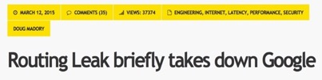
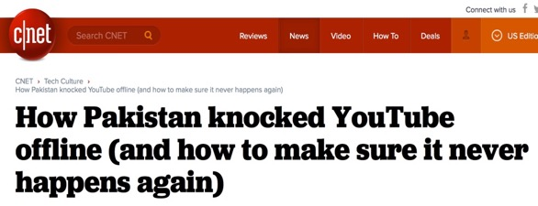



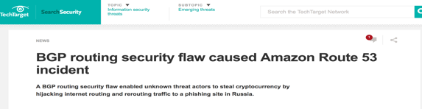
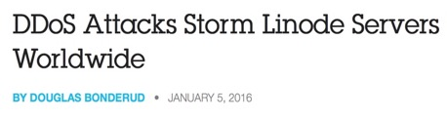




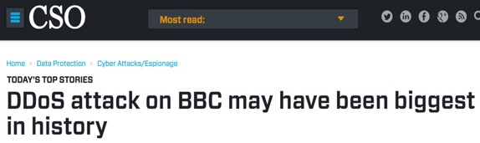


Routing Incidents Cause Real World Problems
Insecure routing is one of the most common paths for malicious threats.
Attacks can take anywhere from hours to months to recognize.
Inadvertent errors can take entire countries offline, while attackers can steal an individual’s data or hold an organization’s network hostage.
Notes:
The threat is real and the need for a fix urgent
MANRS will halt the most common causes of routing incidents
Resources:
Generic Threats to Routing Protocols: https://www.ietf.org/rfc/rfc4593.txt

Slide 8
What are Routing Incidents?
A Routing Security Overview

Slide 9
The Threats: What’s Happening?
Event | Explanation | Repercussions | Solution
Prefix/Route Hijacking | A network operator or attacker impersonates another network operator, pretending that a server or network is their client. | Packets are forwarded to the wrong place; this can cause Denial of Service (DoS) attacks or traffic interception. | Stronger filtering policies
Route Leak | A network operator with multiple upstream providers announces (often due to accidental misconfiguration) to one upstream provider that is has a route to a destination through the other upstream provider. | Can be used for traffic inspection and reconnaissance. | Stronger filtering policies
IP Address Spoofing | Someone creates IP packets with a false source IP address to hide the identity of the sender or to impersonate another computing system. | The root cause of reflection DDoS attacks. | Source address validation
Notes:
This is a summary of the following three slides. (Depending on the audience, you can use this one slide, OR the other three, and don’t need all four slides.)

Slide 10
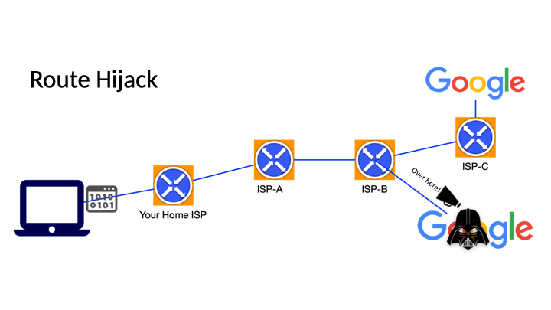
Problem: BGP Hijacks
A network or attacker impersonates another network, pretending that a server or network is their client.
Result: Packets are forwarded to the wrong place; this can cause Denial of Service (DoS) attacks or traffic interception.
Hijacks are usually intentional.

Slide 11
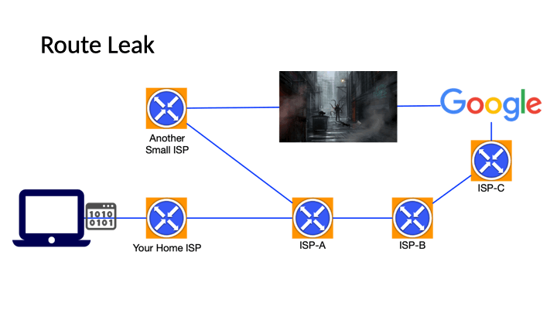
Problem: BGP Leak
A network or attacker advertises illegitimate IP prefixes, which propagate across networks and lead to incorrect or suboptimal routing.
Result: Packets can be redirected through a path that could enable eavesdropping or traffic analysis.
Leaks can be malicious, but are often accidental misconfigurations.

Slide 12
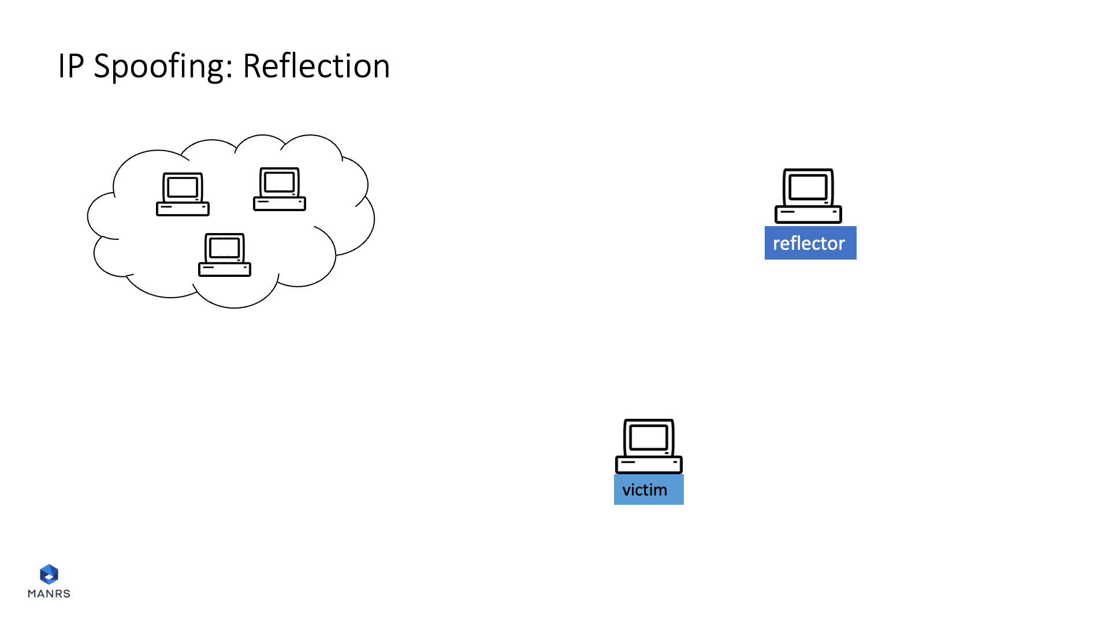
Problem: IP Address Spoofing
Someone creates IP packets with a false source IP address to hide the identity of the sender or to impersonate another network.
Result: Attackers magnify the amount of malicious traffic and obscure the sources of the attack traffic, causing a reflection DDoS attack.

Slide 13
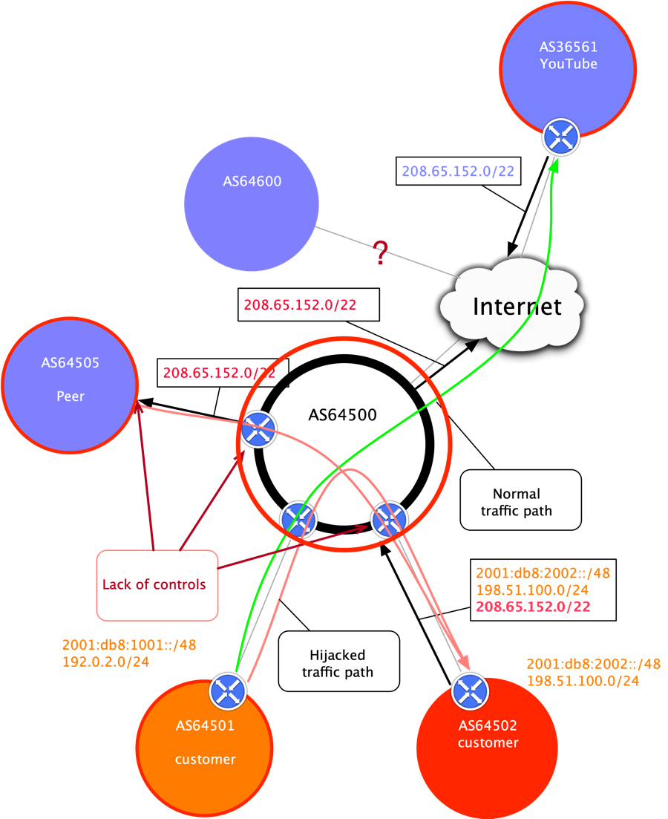
Prefix/Route Hijacking
Route hijacking, also known as “BGP hijacking,” is when a network operator or attacker (accidentally or deliberately) impersonates another network operator or pretends that a server or network is their client. This routes traffic to the wrong network operator, when another real route is available.
Example: The 2008 YouTube hijack; an attempt to block YouTube through route hijacking led to much of the traffic to YouTube being dropped around the world.
Fix: Strong filtering policies (adjacent networks should strengthen their filtering policies to avoid accepting false announcements).

Slide 14
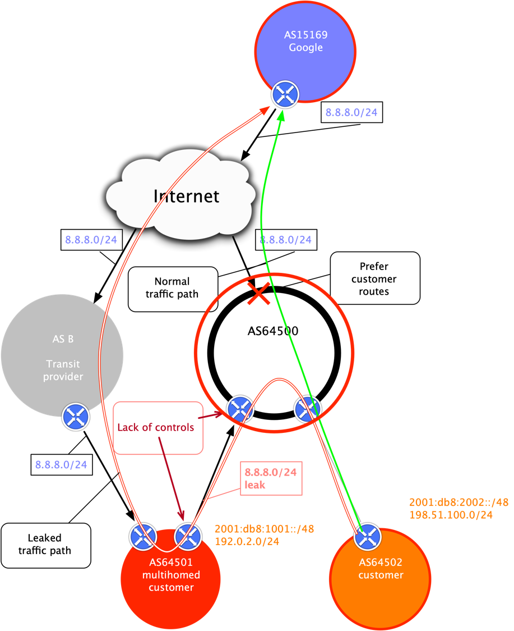
Route Leak
A route leak is where a network operator with multiple upstream providers accidentally announces to one of its upstream providers that is has a route to a destination through the other upstream provider. This makes the network an intermediary network between the two upstream providers, with one sending traffic through the network to get to the other.
Example: 2015, Malaysia Telecom and Level 3, a major backbone provider. Malaysia Telecom told one of Level 3’s networks that it was capable of delivering traffic to anywhere on the Internet. Once Level 3 decided the route through Malaysia Telecom looked like the best option, it diverted a huge amount of traffic to Malaysia Telecom.
Fix: Strong filtering policies (adjacent networks should strengthen their filtering policies to avoid accepting announcements that don’t make sense).

Slide 15
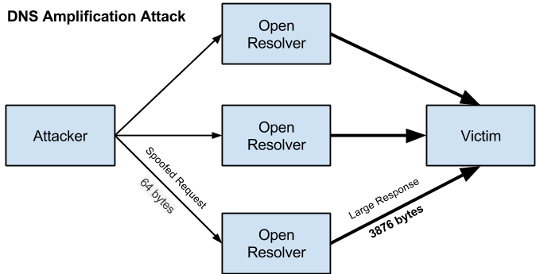
IP Address Spoofing
IP address spoofing is used to hide the true identity of a server or to impersonate another server. This technique can be used to amplify an attack.
Example: DNS amplification attack. By sending multiple spoofed requests to different DNS resolvers, an attacker can prompt many responses from the DNS resolver to be sent to a target, while only using one system to attack.
Fix: Source address validation: systems for source address validation can help tell if the end users and customer networks have correct source IP addresses (combined with filtering).

Slide 16

Tools to Help
  Prefix and AS-PATH filtering
  RPKI validator, IRR toolset, IRRPT, BGPQ3
  BGPSEC
But…
  Not enough deployment
  Lack of reliable data
  We need concerted action to improve routing security.
Notes:
There are various tools to help but they are not deployed often enough and therefore the data is not reliable.

Slide 17

Why is Routing Security Hard?
Every network has a responsibility to implement basic routing security practices to mitigate threats.
But implementing best practices does not bring many immediate benefits. It costs time and money, and you probably can’t charge extra for it.
Even if you do everything right, your security is still in the hands of other networks.
This is a classic collective action problem.

Slide 18
We Are In This Together
Network operators have a responsibility to ensure a globally robust and secure routing infrastructure.
Your network’s safety depends on a routing infrastructure that weeds out bad actors and accidental misconfigurations that wreak havoc on the Internet.
The more network operators work together, the fewer incidents there will be, and the less damage they can do.

Slide 19
The Solution: Mutually Agreed Norms for Routing Security (MANRS)
Provides crucial fixes to reduce the most common routing threats

Slide 20
MANRS improves the security and reliability of the global Internet routing system, based on collaboration among participants and shared responsibility for the Internet infrastructure.
MANRS sets a new norm for routing security.

Slide 21

Mutually Agreed Norms for Routing Security (MANRS)
Industry-led initiative of 1000+ participating networks to implement best practices and collaborate toward a shared vision of a secure routing infrastructure.
MANRS provides concrete actions for Network Operators, IXPs, CDN/Cloud Providers, and Equipment Vendors to reduce or eliminate the most common threats to routing.
There are no fees to join MANRS.
MANRS is supported by the Global Cyber Alliance.

Slide 22
MANRS Programs
Network Operators
Internet Exchange Points
Content Delivery Networks (CDNs) and
Cloud Providers
Equipment Vendors

Slide 23






MANRS Actions
Filtering
Ensure the correctness of your own announcements and of announcements from your customers to adjacent networks with prefix and AS-path granularity
Anti-spoofing
Enable source address validation for at least single-homed stub customer networks, your own end-users, and infrastructure
Coordination
Maintain globally accessible up-to-date contact information
Routing Information
Publish your information, so others can validate routing information on a global scale
Tools
Provide monitoring and debugging tools to help others
Promotion
Actively encourage MANRS adoption among peers, customers, and partners

Slide 24
MANRS Development Process
We are developing a formal process to guide how MANRS documents are developed, adopted, and maintained.
Objectives:
Increase credibility, transparency and inclusiveness: a formal, documented mechanisms to develop and modify MANRS documentation (MANRS Actions, MANRS Charter…)
Introduce a formal document series: this provides stable references and version control, making it easier to refer to it in external documents
Proposal
Announcement
Development
Public Comments
Approval and Publication

Slide 25
The Business Case for MANRS
and Routing Security
Notes:
https://www.manrs.org/wp-content/uploads/sites/14/2017/10/MANRS-451-Study-Report.pdf

Slide 26
Implementing MANRS Actions
Signals an organization’s security-forward posture and can eliminate SLA violations that reduce profitability or cost customer relationships.
Reduces routing incidents, helping networks readily identify and address problems with customers or peers.
Improves network’s operations by establishing better and cleaner peering communication pathways, while also providing granular insight for troubleshooting.
Addresses many concerns of security-focused enterprises and other customers.

Slide 27
The Role of Routing in Supply Chain Security
85% of all ASes are origin-only networks. They fully depend on their connectivity provider for accessing their external digital assets and the Internet.
Despite being origin-only, most enterprise networks can contribute to a better routing security by:
Implementing routing security best practices in their network infrastructure
Demanding proper routing security controls from their connectivity and cloud providers
Is your connectivity or cloud provider the first line of defense... or your weakest link?
Notes:
Add note to this slide

Slide 28
Everyone Benefits
Joining MANRS means joining a community of security-minded organizations committed to making the global routing infrastructure more robust and secure.
Consistent MANRS adoption yields steady improvement, but we need more networks to implement the actions and more customers to demand routing security best practices.
The more networks apply MANRS actions, the fewer incidents there will be, and the less damage they can do.

Slide 29

MANRS is an Important Step
Security is a process, not a state. MANRS provides a structure and a consistent approach to solving security issues facing the Internet.
MANRS is the minimum a network should consider, with low risk and cost-effective actions.
MANRS is not a one-stop solution to all the Internet’s routing woes, but it is an important step toward a globally robust and secure routing infrastructure.

Slide 30
Why Service Providers Should Join MANRS
To help solve global network problems
        Lead by example to improve routing security and ensure a globally robust and secure routing infrastructure
        Strengthen enterprise security credentials
To add competitive value and differentiate in a flat, price-driven market
        Growing demand from enterprise customers for managed security services (info feeds)
        Signal security proficiency and commitment to your customers
To expand service portfolio - from a connectivity provider to a security partner
        Information feeds and other add-on services may increase revenue and reduce customer churn
        Enterprises indicate willingness to pay more for secure services
Notes:
Promote MANRS compliance in marketing materials to security-focused customers
To increase and/or add revenue streams
Enterprises indicate willingness to pay more for secure services
Information feeds and other add-on services may increase revenue and reduce customer churn

Slide 31
Why Enterprises Should Require MANRS
To improve your organizational security posture
  MANRS-ready infrastructure partners increase security and service reliability, while eliminating common outages or attacks
  Requiring MANRS adoption can help enterprises demonstrate due diligence and regulatory compliance
To prevent and address security incidents
  Preventing traffic hijacking, detouring, and malicious traffic helps prevent data loss, denial of service, reputational damage, and more
  Attacks and outages are resolved promptly by MANRS participants who are part of a broad network of security-minded operators
MANRS provides a foundation for value-added services
  Incident information sharing and information feeds can directly impact the bottom line
  Organizations can improve SLA compliance and address a host of routing deficiencies by simply seeking providers that adopt MANRS
Notes:
To signal to your customers that you care about and invest in security matters – both yours and theirs
Promote MANRS compliance in B2B communications as a market differentiator

Slide 32
Why Governments Should Promote MANRS
To drive the development or adoption of best practices across the country
  Encourage industry associations to develop or strengthen and promote existing voluntary codes of conduct for network operators.
  MANRS can serve as both a baseline set of best practices and as a foundation to complimentary voluntary codes of conduct.
To encourage the use of routing security as a competitive best practice
  Encourage local industry to better convey security to consumers and specify security during procurement practices.
To lead by example
  Improve infrastructure reliability and security by adopting best practices in their own networks.

Slide 33
Why Research & Education Networks Should Join MANRS
To show technical leadership and distinguish you from commercial ISPs
  Customers increasingly willing to pay more for secure services
To add competitive value and enhance operational effectiveness
  Growing demand from customers for managed security services
To show security proficiency and commitment to your customers
  Promote MANRS compliance to security-focused customers
To help solve global network problems
  NRENs are often early adopters of new developments. Lead by example and improve routing security for everyone
  Being part of the MANRS community can strengthen enterprise security credentials

Slide 34
MANRS Observatory
Notes:
https://www.manrs.org/wp-content/uploads/sites/14/2017/10/MANRS-451-Study-Report.pdf

Slide 35

MANRS Observatory
Provides a factual state of security and resilience of the Internet routing system and tracks it over time
Measurements are:
Transparent – using publicly accessible data
Passive – no cooperation from networks required
Evolving – MANRS community decide what gets measured and how

Slide 36
MANRS Observatory Access
Launched in 2019
Uses trusted, publicly available third-party data
Anyone may view aggregated data
Only MANRS Participants have access to detailed data about their own network(s)
Caveats:
There are still some false positives
Lack of security controls is not always visible

Slide 37
MANRS Observatory

Slide 38
MANRS Observatory

Slide 39
An Elevated Tier of MANRS Participation
MANRS has traditionally focused on peer-to-peer relationships between network operators, but we believe customer demand can be a driving force in increasing routing security.
If we can enhance the business case for MANRS, customers will demand better routing security of their network connectivity providers and providers will ensure they’re complying with the MANRS Actions that mitigate routing security risks.
The MANRS+ Working Group explores the idea of creating a second, elevated tier of MANRS participation for organizations that comply with more stringent requirements and auditing. The working group is tasked with developing the requirements for MANRS+.

Slide 40
Meet MANRS+
A framework for routing security, an essential part of supply chain security
Focus on the demands of enterprise customers in various industry sectors
Extended set of requirements, covering a broader set of risks related to routing and traffic security
Conditioned to be included in / referenced from common infosec frameworks:
  Stronger and more detailed requirements enforcing best practices in traffic security
  High level of assurance of conformance; this includes more profound technical audit and process audit
Developed in a transparent and inclusive manner using the MANRS Development Process (MDP)
Notes:
Add note to this slide

Slide 41







The Control Matrix
What Should Enterprises Require from their Connectivity Provider?
Routing Security
7 Controls
DDoS Attack Mitigation
4 Controls
Anti-spoofing Protection
2 Controls
Maintaining Routing Info.
3 Controls
Global Communication
1 Control
Security Services
3 Controls

Slide 42
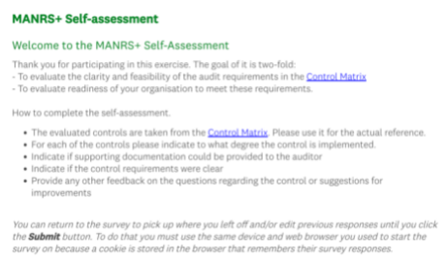

Self-Assessment Survey
Objectives:
To evaluate the clarity and feasibility of the audit requirements in the Control Matrix
To evaluate readiness of your organization to meet these requirements
Basis for the future application form
The self-assessment survey is online:
https://www.surveymonkey.com/r/86GGHC5
Notes:
Add note to this slide

Slide 43
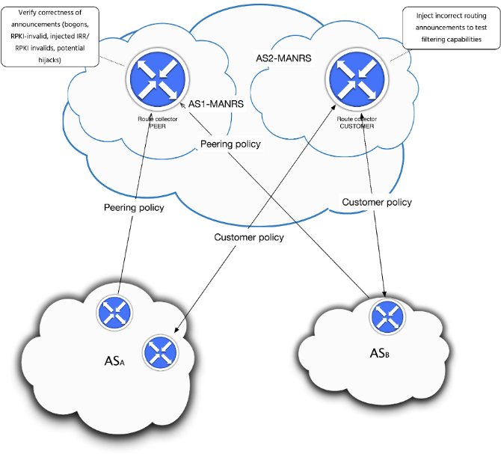
Future MANRS+ Work
Gather interested organizations among connectivity providers and enterprises
Develop a prototype and deploy the enhanced measurement infrastructure
Work on the inclusion in common infosec frameworks (eg.: M3AAWG Internet Routing Security Profile based on NIST CSF)

Slide 44
Learn More and
Join Us

Slide 45
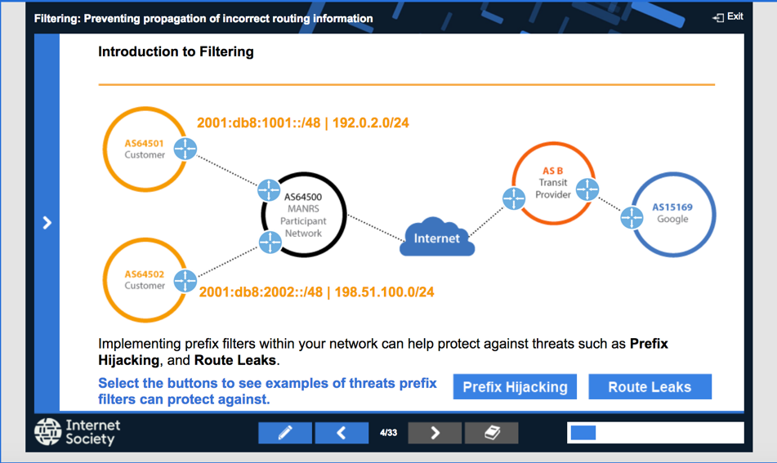
Help Is Available
If you’re not ready to join yet, implementation guidance is available to help you.
Implementation Guide based on Best Current Operational Practices deployed by network operators around the world
Tutorial modules based on information in the Implementation Guide.

Slide 46
MANRS Implementation Guide for Network Operators
If you’re not ready to join yet, implementation guidance is available to help you.
Based on Best Current Operational Practices deployed by network operators around the world
Recognition from the RIPE community by being published as RIPE-706
  https://www.manrs.org/bcop/

Slide 47

MANRS Tutorials
Tutorials based on information in the Implementation Guide
Walks through the tutorial with a test at the end of each module
Working with and looking for partners that are interested in integrating it in their curricula
https://www.manrs.org/tutorials

Slide 48
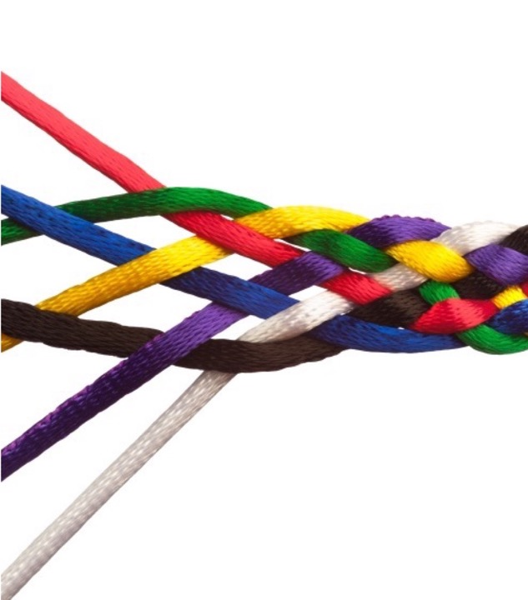
Join Us
Visit https://www.manrs.org/join
  Fill out the form with as much detail as possible.
  We will ask questions and run tests
Get Involved in the Community
  Members support the initiative and implement the actions in their own networks
  Members maintain and improve the documents and promote MANRS objectives

Slide 49



LEARN MORE:
https://www.manrs.org
FOLLOW US:
/RoutingMANRS

Slide 50
NAME
EMAIL

